Slide 1
Online communication channels
Workpackage:
D.2.
Natura 2000 Communication Training Manual for Natura 2000 managers in Europe
Project: Efficient Managers for Efficient Natura2000 Network
The production of this presentation has been supported financially in the framework of the European Commission’s DG Environment´s LIFE+ Communication programme
Created by EUROPARC Federation

Slide 2
Why going viral?
Why connecting online?
Why use online networking?

Slide 4
For those of us in the nature protection communication, social media tools such as Facebook, Twitter, and blogs allow us to expand our reach, foster engagement, and increase access to credible, nature - based messages.
Social media is also a key tool in building awareness and credibility.

Slide 5
Social media can help organizations achieve the after goals:
Disseminate information in a timelier manner.
Engage with the public.
Leverage networks of people to make information sharing easier.
Increase the potential impact of important messages.
Create different messages to reach diverse audiences.
Personalize health messages and target them to a particular audience.
Create different messages to reach diverse audiences.
Empower people to make safer and healthier decisions.

Slide 6
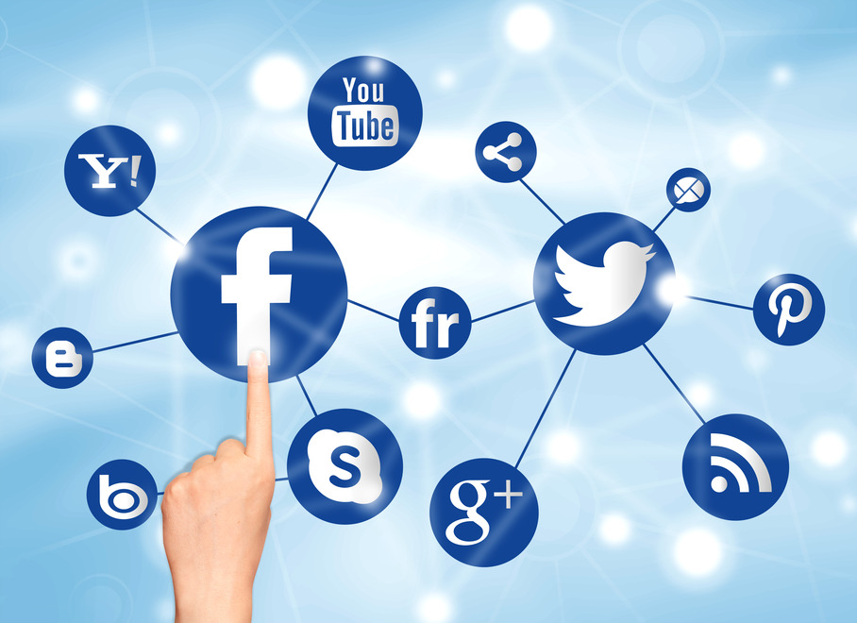
Social Media and Communication Strategy
Keep in mind - social media is just one tool in a larger communication strategy!
Always consider your overall communication goals when developing social media activities.
Keys to an effective social media presence are to:
Identify your target audience.
Determine your objective.
Select the appropriate channel for your message.
Decide upfront how much time and effort you can invest.

Slide 7
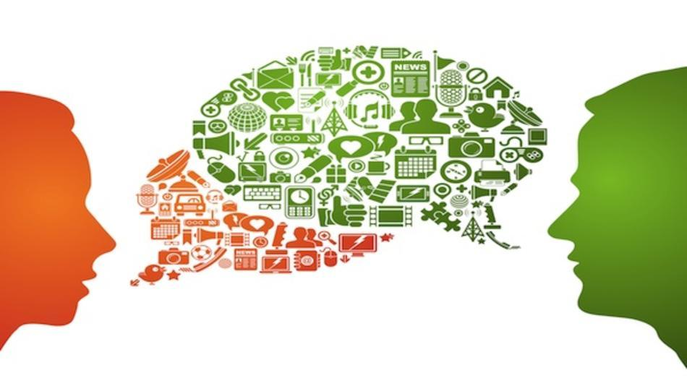
Principles of Effective Social Media Writing - Creating Content
Social media content should be:
Relevant, useful, and interesting
Easy to understand and share
Friendly, conversational, and engaging
Action-oriented

Slide 8
Use Your Web Content as Source Material for Social Media Content
Any kind of Web content can provide the source material for a tweet, Facebook post, or text message, including:
News articles
Fact sheets
FAQs
Outbreak notices
Event or conference
Research reports
Guidelines

Slide 9
Checklist Writing for Social Media
Length
Posts can be up to 250 characters (including spaces).
Tweets should be 120 characters or less, including a shortened URL.
Access to more information
Hyperlink to a Web page, photo, or video.
Include information available through other social media channels: a short code for texts; a hashtag for Twitter.
Include a hyperlink to a website, an @ mention, or a hashtag #.
Call to action
Invite followers to do something such as watch a video, attend an event, or use CDC resources.
Start the tweet with a verb if possible: Use watch, read, learn, etc.
Tone
Write in a friendly, casual style. Avoid jargon.
Write in friendly, action-oriented style.
Tagging / Mentions
Use the @ symbol in front of a public health partner’s name in your post to automatically create a link and display the post on the partner’s page.
Use the “@“ symbol in front of a public health partner’s name in your post to automatically create a link and display the post on the partner’s profile.
Abbreviations
Avoid abbreviations, but if they are necessary, use sparingly and only if easily understood. automatically create a link and display the post on the partner’s page.
Avoid abbreviations, but if they are necessary, use them only if they are easily understood, do not change the meaning of the tweet, and are not immature or unprofessional.

Slide 10
Direct mailing – Newsletters
Failing to take care with your email marketing strategy will be detrimental to your relationship with your audience!
Consider:
Measuring effects
Choosing content
Testing messages
Subscribing / Unsubscribing
Social Media vs.Newsletters

Slide 11
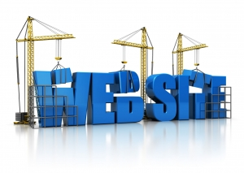
Websites, blogs…
The strongest marketing tool and often the first place participants go to get information.
Why Blogs?
Blog's give an opportunity to write content that is unique to you and your Protected Area. While some people/ organisations are uncomfortable with self-promotion, blog gives you an occasion to interact with your visitors while promoting who you are and what you do.
1. Establishing expertise.
2. Establishing “real” credibility.
3. Building a professional community.
4. Creating relationships with stakeholders.
5. Drive targeted traffic to your main web site.

Slide 12
The production of this presentation has been supported financially in the framework of the European Commission’s DG Environment´s LIFE+ Communication programme. The content of this publication does not reflect the official opinion of the European Union.
Responsibility for the information and views expressed in the publication lies entirely with the authors.

